Slide 1
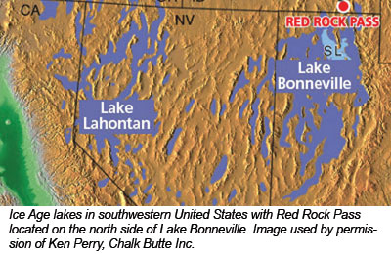
Isostatic rebound, active faulting, and potential geomorphic effects in the Lake Lahontan basin, Nevada and California
Kenneth D. Adams, Steven G. Wesnousky & Bruce G. Bills (1999)

Slide 2
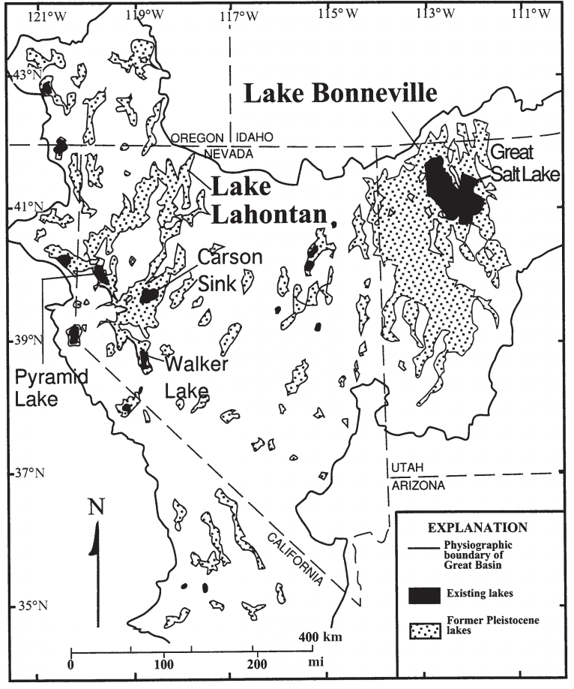
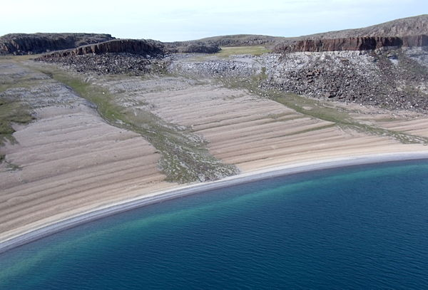
Purposes of this paper:
Present evidence for the magnitude and character of deformation in the Lahontan basin since 13 ka
Discuss potential geomorphic effects invoked by the deformation

Slide 3
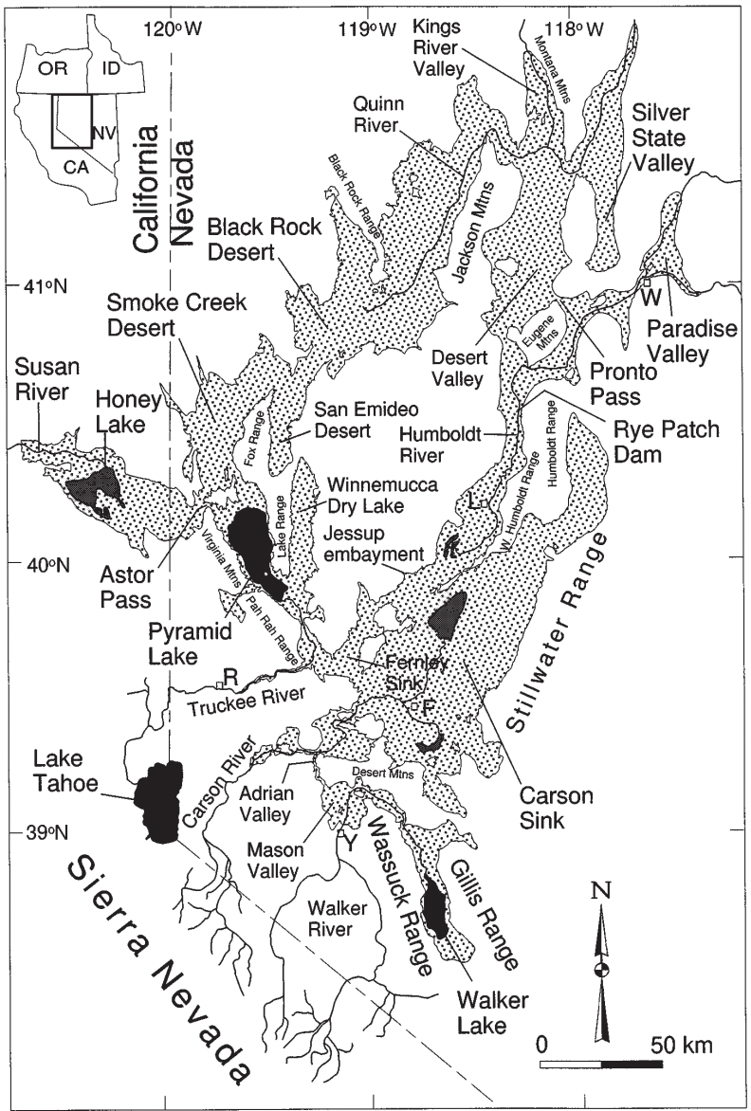
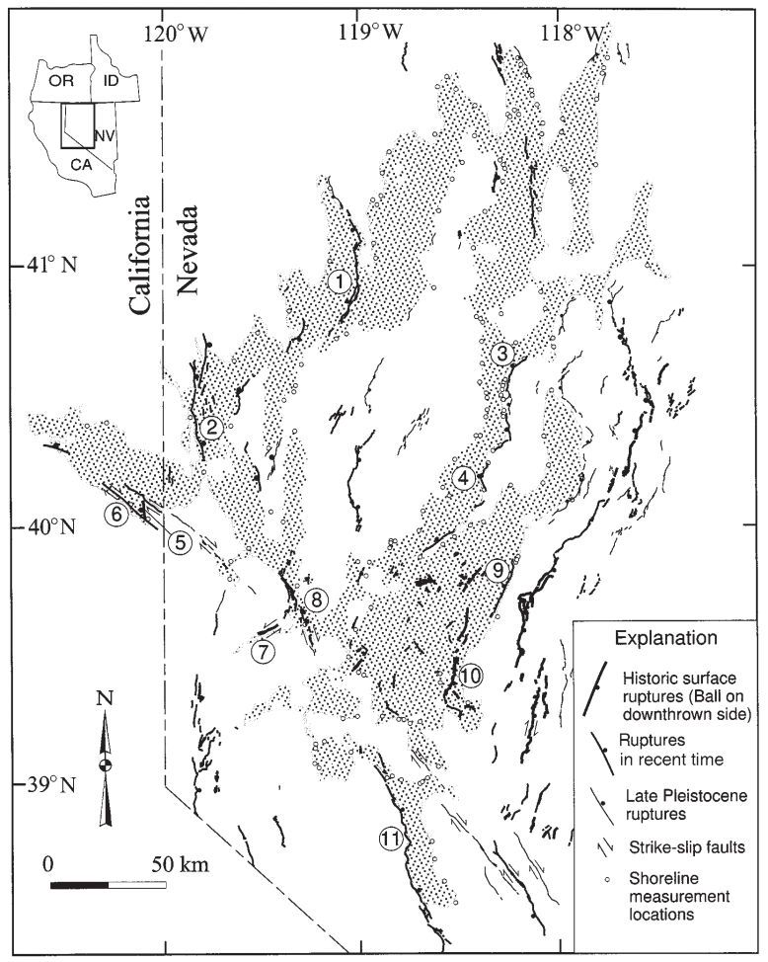

Slide 4
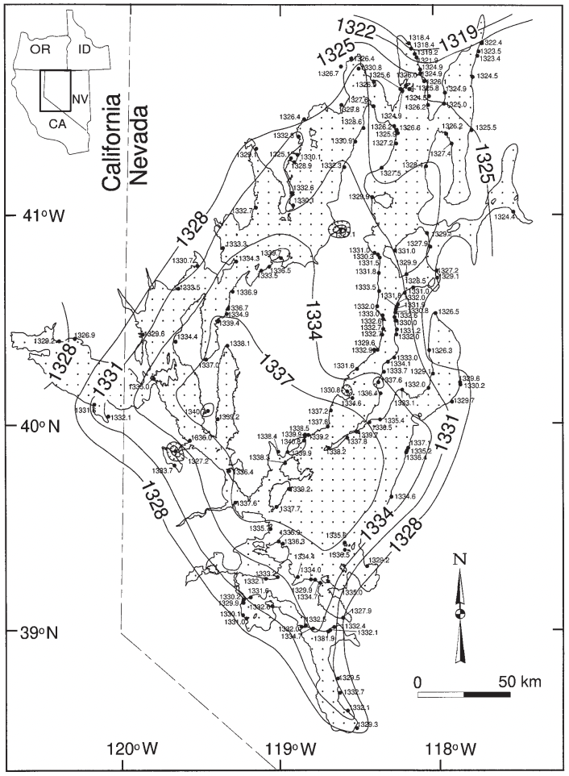
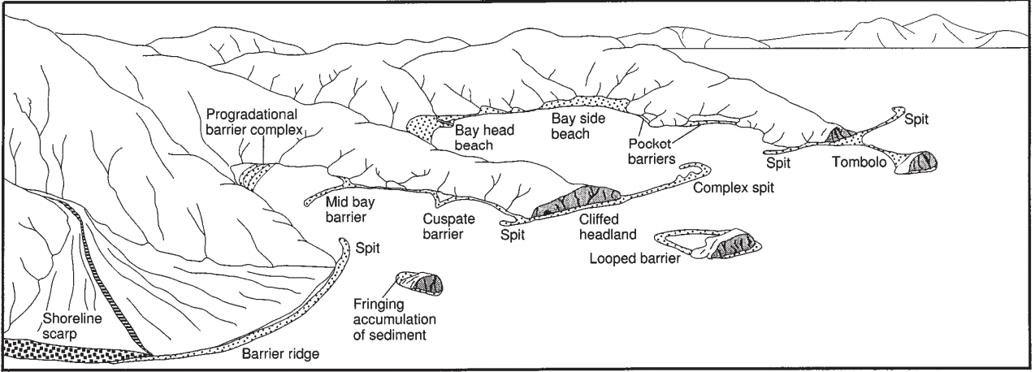
The geomorphic record of Lake Lahontan is evidenced by wave-formed terraces, beach cliffs, spits, barriers, and other wave-formed features found at the elevation of the highstand.

Slide 5
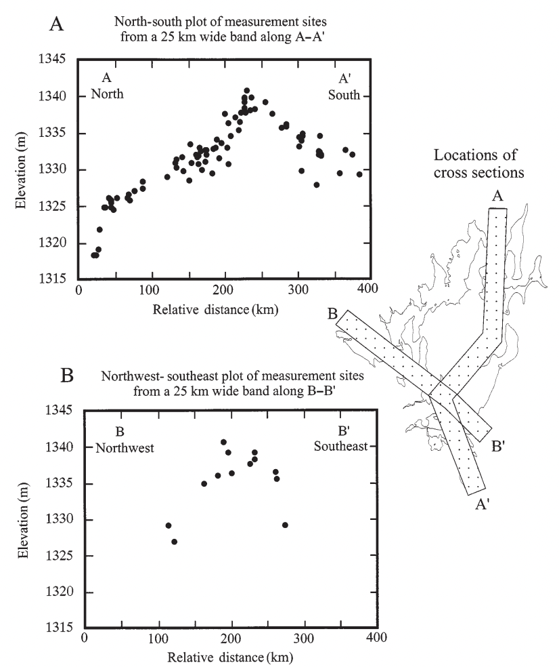
North-south and northwest-southeast cross sections of high shoreline elevations across the basin document lithospheric flexure.
N-S cross section displays ~2 m difference in the elevations of high shorelines.
NW-SE shows ~15 m elevation change.

Slide 6
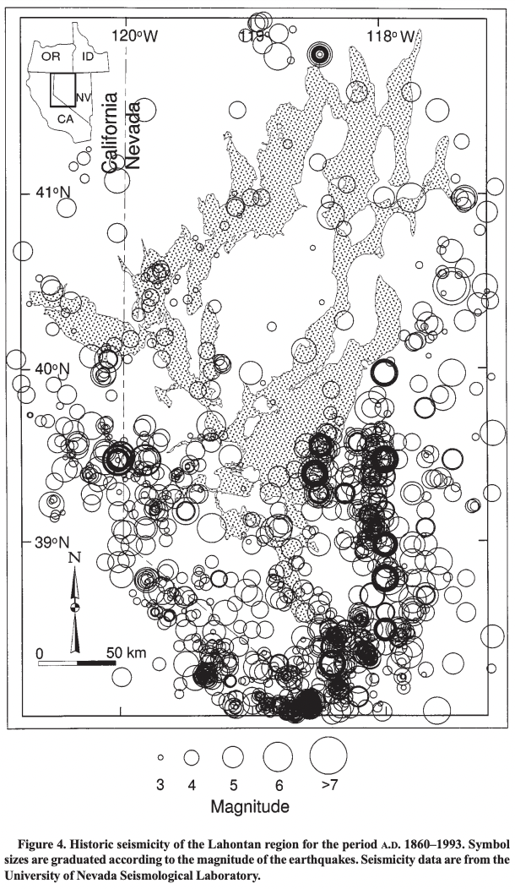
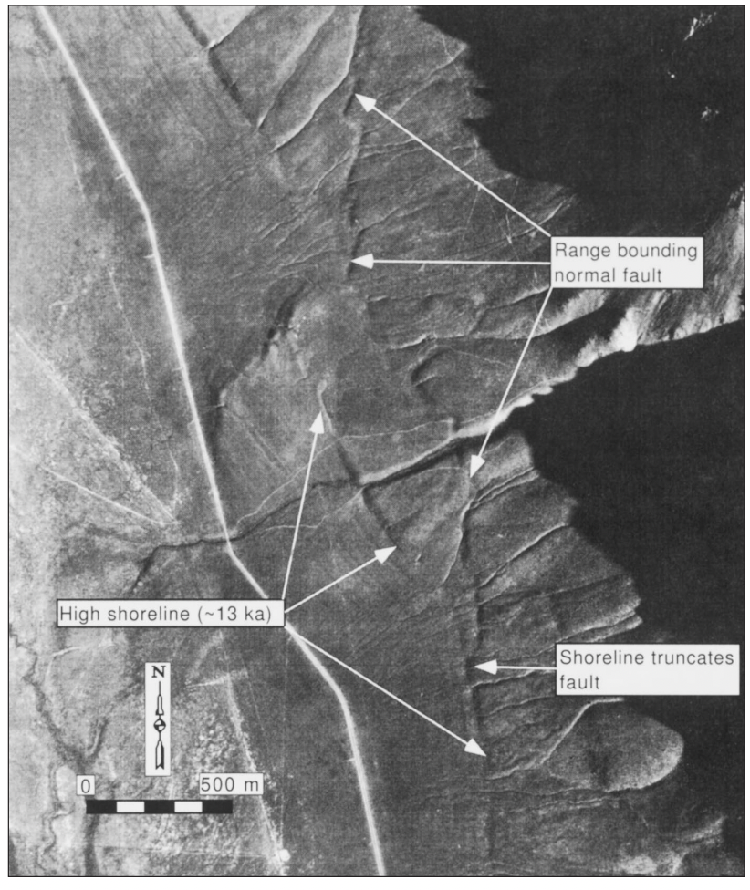
Thatcher (99’) - the region occupied by Lake Lahontan is deforming more rapidly than the rest of the Great Basin.
Active faults locally offset the high shoreline, but cannot explain the regional upwarping attributed to isostatic rebound since 13 ka.
Truncations demonstrate that the most recent ruptures along these faults occurred prior to 13 ka.

Slide 7
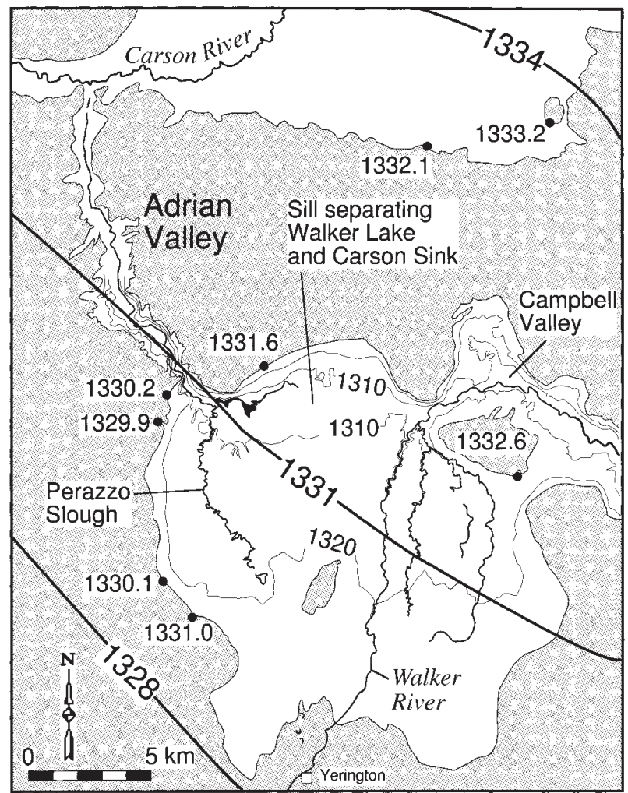
Rapid uplift in the basin, coincident with the rapid desiccation of the lake, may have diverted major rivers into different terminal basins.

Slide 8
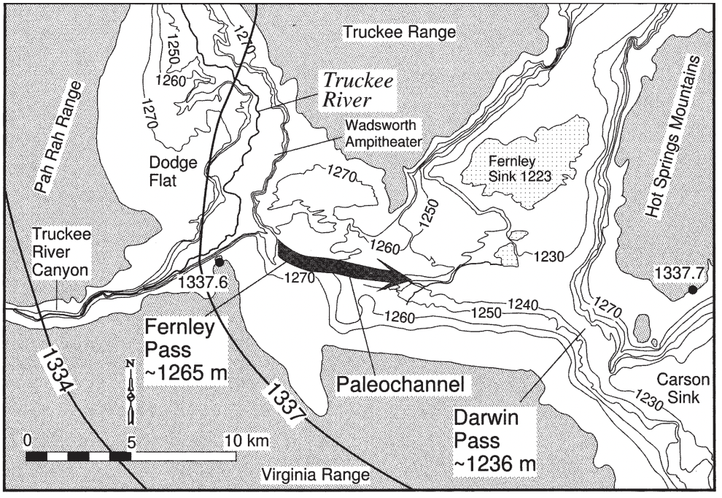

Slide 9
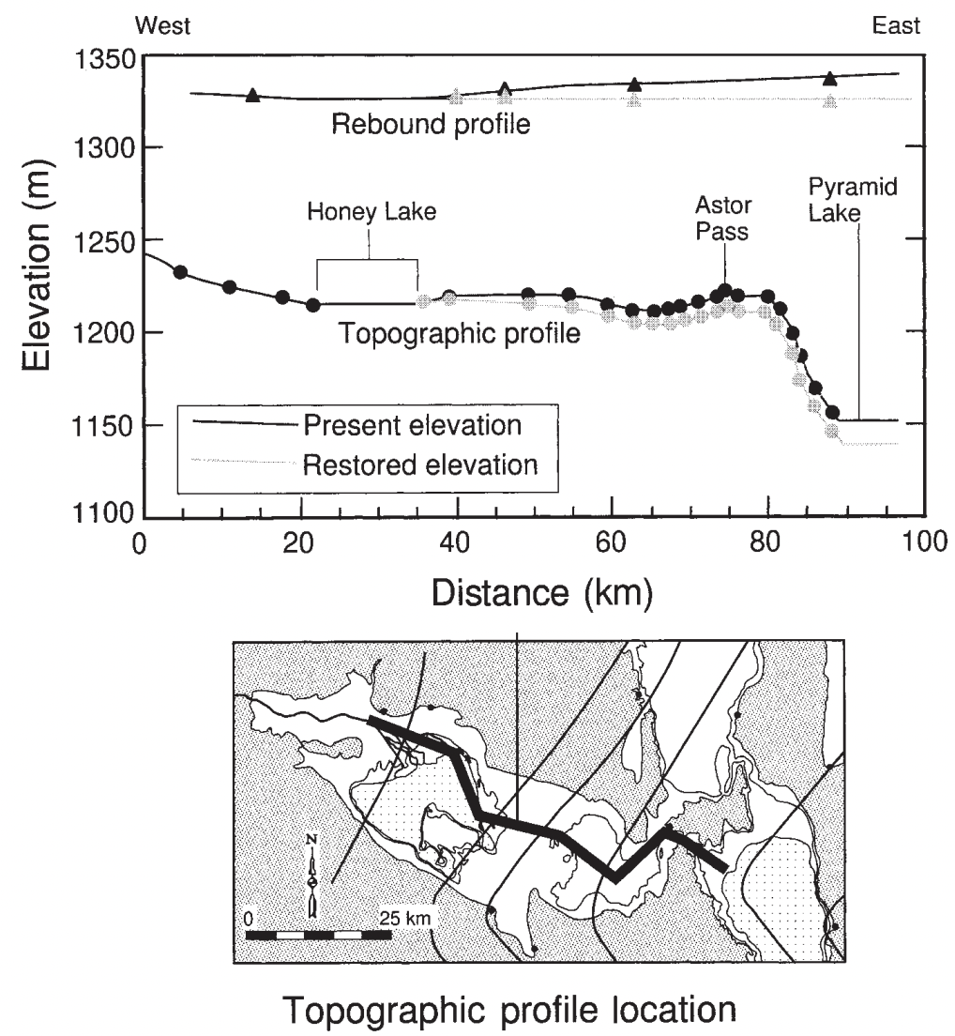
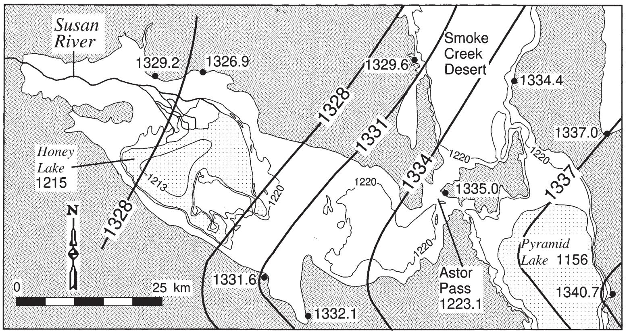
The 1220 m topographic contour is designated by a thin gray line, and rebound contours are designated by thick black lines
If uplift due to isostatic rebound is restored back to the horizontal then eastern Honey Lake Valley would have an east-sloping gradient.

Slide 10
The total vertical deformation on this once horizontal surface is about 22 m.
In each (river) case, the rivers appear to be deflected away from the local rebound gradient.

